Slide 1
DataHub for Manufacturing
Hands-on Session

Slide 2
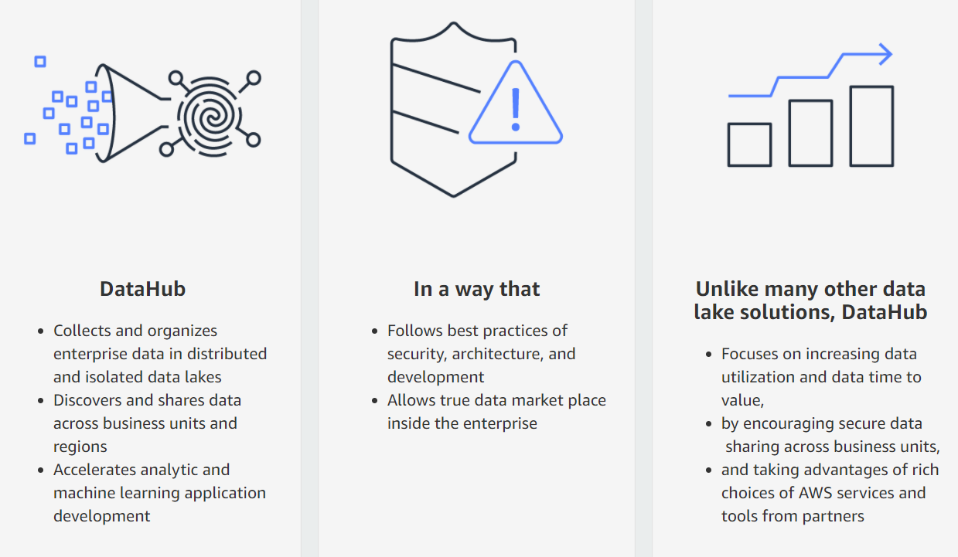
Datahub value proposition

Slide 3
Program
App Management (Multipass, URL, Session management, etc.)
User Account Management in Cognito
Organization management
Environment management
Dataset manipulations: Creating & Populating
Data sharing & Data shopping
Dashboards in Datahub
Querying data in Datahub
Jupyter Notebooks in Datahub
Dataset Deletion, Environment archiving

Slide 4
App Management
Tooling account : 456929711546 GD-S-E0-DATA-DATAHUB-TOOLING
Git Repository
Multipass quick de-activation
Managing Session duration
Customizing app URL

Slide 5
User Account Management
Multipass vs Local Users
Creating a Local user
Creating a group
Mapping a user to groups

Slide 6
Organizations
NB: Different from AWS Organizations
A datahub organization is a high level container that maps to an organizational unit. Not AWS Organizations. Use organizations to isolate data, compute and costs .
Creating an organization
Roles in an Org: Owner/Admin, Member, (outsider)
Manufacturing AMERICAS
Admin group: amer-admins
Manufacturing EMEA
Admin group: emea-admins
Manufacturing APAC
Admin group: apac-admins

Slide 7
Environments
Organizations can contain multiple Environments
1 Environment = 1 Business Unit = 1 Group of users
An Environment is Linked to 1 AWS Account x 1 Region
Datahub Tooling account 456929711546
Manufacturing AMERICAS
Admin group: amer-admins
Manufacturing EMEA
Admin group: emea-admins
Manufacturing APAC
Admin group: apac-admins
Medical Gases – EMEA
978745112501 – eu-west-1
Group: emea-members
Medical Gases – Americas
167842893001 – eu-west-1
Group: amer-members
Medical Gases – APAC
544247218144 – eu-west-1
Group: apac-members
Global Sales Reporting
544247218144 – eu-west-1
Group: sales-reporting-members
Notes:
1 Global Sales Analyst voudrait récupérer les données des différentes équipes Medical Gases dans le monde.

Slide 8
Creating Environments
4 prerequisites:
Cdk bootstrap the Env account
Create a datahubPivotRole in the Env account
Enable Quicksight in the Env account
Create a data location in LakeFormation of the Env Account
A CloudFormation stack then creates a Default Role, LakeFormation Default Settings, Event rule, Event Bus, Lambda Functions
Roles in an Environment: Admin (= Admin of the org), Invited, Non invited
Members & Admin only can generate a Console Link or CLI credentials to the target AWS Account with a role created for the environment, as well as see datasets and shared datasets.

Slide 9
Manipulating Datasets
Datasets englobes Data Tables & Folders
Need to be member (or Admin) of an Environment to Create & Edit Datasets
Creating a Dataset. (Cloudformation stack generates resources in IAM, S3, Glue and KMS)
Upload a Table, Crawler (5 min)
Create a Folder
Tables menu:
Metadata
Preview
Data Quality profiling
Summary & Details section
Console & CLI Access with the Dataset’s Role. User Credentials for external communication.
Access Glue & S3

Slide 10
Sharing data to another environment
A sales analyst based in EMEA needs to access the sales data for Medical Gases in the Americas & EMEA Regions, to aggregate sales reports globally.
Manufacturing AMERICAS
Admin group: amer-admins
Manufacturing EMEA
Admin group: emea-admins
Medical Gases – EMEA
978745112501 – eu-west-1
Group: emea-members
Medical Gases – Americas
167842893001 – eu-west-1
Group: amer-members
Global Sales Reporting
544247218144 – eu-west-1
Group: sales-reporting-members

Slide 11
Sharing data to another environment
A sales analyst based in EMEA needs to access the sales data for Medical Gases in the Americas & EMEA Regions, to aggregate sales reports globally.
Manufacturing AMERICAS
Admin group: amer-admins
Manufacturing EMEA
Admin group: emea-admins
Medical Gases – EMEA
978745112501 – eu-west-1
Group: emea-members
Medical Gases – Americas
167842893001 – eu-west-1
Group: amer-members
Global Sales Reporting
544247218144 – eu-west-1
Group: sales-reporting-members

Slide 12
Sharing data to another environment
Option 1: The Sales Analysts shops its data in the Discovery Catalog & asks for access
Option 2: A member of the Americas Environment asks for the Sales Analysts to get access
Approval/Denial by the business owner of the dataset
Access the AWS Console from the Environment menu
Accept the RAM invite
See the newly added tables, databases and access to S3
Query from Athena across environments
Note: Tables & Folders can be un-shared by the business owner as well

Slide 13
Creating Queries
Queries are associated with an environment, which determines their access to data
The SQL syntax is the same as Athena (DML: Presto 0.172, DDL: HiveQL)
Dataset details section give the name of the Glue database
Queries Results are stored in S3, in the environment’s AWS account

Slide 14
Creating Notebooks
Notebooks are associated with an environment, which determines their access to data
Integrated Sagemaker notebook, with Sagemaker examples & kernel selection
Access to datasets & shared datasets via boto3 call + PyAthena
Jupyter or JupyterLab view

Slide 15
Creating Dashboards
Dashboards are associated with an environment, which determines their access to data
They are generated on Amazon Quicksight
Discovery Catalog, Notebooks, Dashboards & Queries are accessible to outsiders (users outside of their associated environment)

Slide 16
Deleting/Archiving resources
Deleting a dataset (Hard Delete, All underlying resources suppressed) or archiving a dataset (Soft Delete, removing the item from the UI) is accessible to the dataset admins/creator (i.e. the Environment members)
Archiving an environment archives all its resources (datasets, dashboards, etc.)

